Slide 1
English for Business
Business Communication

Slide 2
Communication
Communication takes place when one person transmits ideas or feelings to another person or group of people.
The effectiveness is measured by the similarity between the idea transmitted and the idea received.
Message
Transmitted / Send
interpret

Slide 3
Effective Communication
The process of communication is composed of three elements:
the source (sender, speaker, transmitter, or instructor),
the symbols used in composing and transmitting the message (words or signs), and
the receiver (listener, reader, or student).
The three elements are dynamically interrelated since each element is dependent on the others for effective communication to take place.
The relationship is dynamic and depends on the two-way flow of symbols between source and receiver.
The source depends on feedback from the receiver to properly tailor the communication to the situation.
The source also provides feedback to the receiver to reinforce the desired student responses

Slide 4
The Method of Communication
Delivering messages to other could be handed :
Orally
Written
Symbol
Formal Business Communication
Letters (business letter)
Presentation
Oral

Slide 5
Business Letters
A business letter is letter used in business to communicate to other company.
A business letter is usually used for correspondence between such organizations and their customers, clients and other external parties.
The overall style of letter will depend on the relationship between the parties concerned.
Reasons to write a business letter :
To request direct information or action from another party,
To order goods or supplies from a supplier,
To identify a mistake that was committed,
To reply directly to a request,
To apologize for a wrong or simply to convey goodwill.
Asking and answering an job application
The business letter is still very useful because it produces a permanent record, is confidential, formal and delivers persuasive, well-considered messages

Slide 6
General Format
[SENDER'S ADDRESS]
(optional) [SENDER'S PHONE]
(optional) [THE SENDER'S E-MAIL]
[DATE]
[RECIPIENT W/O PREFIX]
[RECIPIENT'S COMPANY] [RECIPIENT'S ADDRESS]
(Optional) Attention [DEPARTMENT/PERSON],
Dear [RECIPIENT W/ PREFIX]:
[First Salutation then Subject in Business letters]
[CONTENT.]
[CONTENT.]
[COMPLIMENTARY CLOSING , (Sincerely, Respectfully, Regards, etc.)],
[SENDER]
[SENDER'S TITLE]
Enclosures ([NUMBER OF ENCLOSURES])

Slide 7
Business Letter
Example

Slide 8
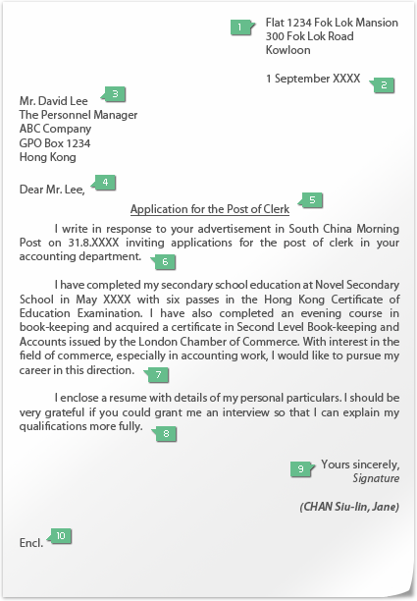

Slide 9
information
01_Applicant’s address
02_Date
03_Write in the following sequence:
Name of the responsible officer
Post title of the responsible officer
Name of the organization
Address of the organization
04_Addressee
Address to the responsible officer as far as you can, e.g., Mr Lee, otherwise, write “Dear Sir/Madam”
05_Title
State the relevant post

Slide 10
information
06_First Paragraph
State again the post you are applying for and explain how the vacancy is known
In the first paragraph of an unsolicited application letter, you should state the post or job area you are interested in and the reason for making self-referral
07_Content
List the relevant academic qualifications and experience to show that you are the best person for the post
08_Last Paragraph
Indicate your wish for an interview
09_Closing
Use “Yours sincerely” if you are addressing to the responsible officer; otherwise, use “Yours faithfully”
Sign your name below the closing remark and type your name under the signature
10_Enclosures
Resume, copy of certificates and work proofs should be attached to the letter

Slide 11
Avoiding Common Mistakes
During Job’s Interviews

Slide 12
Common Mistakes
Common mistakes to avoid during job interviews, don’t do this
If you had a job before you will be asked why you left and it is best if you don’t talk rude about your ex-boss even if he was the worst out there. So be sure to avoid condemning your other employers.
You should show your possible employer that you know how to solve problems, not create them
Avoid to being anxious about the offered salary because this will be discussed for sure..
If you are going to use a person, make sure that you have the consent of that person, because this will save you from embarrassing yourself.

Slide 13
Common Mistakes
Common mistakes to avoid during job interviews,
If you are requested to fill out a standard application, please never write “see resume for requested info” on an application form, be sure to always write down the wanted information again. Show interest in the company or product.. Appearance is not everything, but make sure to have decent clothes, adequate to the job and the company you are applying, take care of your hair, nails and avoid excessive jewelry. Remember that you are trying to make a favorable impression, so do your best to avoid a possible rejection because of clumsy mistakes.

Slide 14
Some Tips
Proper Job Interview Dress Code for Men:
Choose a conservative and professional-looking suit. Preferably, it must be navy blue, black, or dark grey in color.
If you do not have a suit, wear a long-sleeved polo shirt on the interview.
Wear a necktie with basic color and patterns. Avoid jazzy designs or too colorful ties that look unprofessional
If possible, do not wear any jewelry except for basic items such as a watch. Wear socks that match the color of your pants.
Carry your resume or other important documents required to bring during interview in a briefcase.
Cut your hair short or neatly style it.
Do not wear perfume, especially the ones that have pungent scent
Clean your fingernails by trimming them. Also, clean shave your face.

Slide 15
Some Tips
Proper job Interview Dress Code for Women: Wear a conservative business suit, whether you prefer pants or skirt.. Make sure that the skirt or pants are well fitted and not too tight. When pairing your pants or skirt, choose professional and no-frills blouses. Opt for professional colors such as cream, pale blue, or white. Avoid wearing blouses that have a low neckline. Wear leather shoes. If you can find any, opt for shoes that match the color of your outfit. If not, then settle for neutral colors so it would suit whatever you are wearing. Minimize your use of jewelry. Stick to the basics such as a watch or earrings. Wear simple and natural looking makeup..

Slide 16
Thank You
Good Night

